Slide 1

How to Navigate the NCAA Process
Olathe School District
Pat Butler, Olathe West Athletic Director

Slide 2
The Game Plan……
General overview of initial-eligibility rules
Certification Process
Roles and Responsibilities
Where are the bumps in the road?
Help! (and contact information)

Slide 3

2.3 or take a Knee: GRADES MATTER!!!
http://www.adforum.com/creative-work/ad/player/34496129/talking-bench/ncaa

Slide 4
NCAA Division I Eligibility
Students will need to meet the following requirements to receive athletics aid, practice and compete their first year:
16 Core Courses in the following areas:
  4 years of English
  3 years of math at Algebra I level or higher
  2 years of natural or physical science (one lab class required)
  1 year of additional English, math or natural/physical science
  2 years of social science
  4 years additional coursework from areas above or foreign language
Minimum required GPA
  Minimum GPA of 2.300 in those 16 core courses

Slide 5
Standardized Tests Waived for 23-24 Enrollment
As of January 2023, standardized test scores are not required for all student-athletes who initially enroll full time on or after August 1, 2023. During the 2023 NCAA Convention, Divisions I and II adopted legislation to remove standardized test scores for these students. Last year, NCAA research found that about 23% of Division I schools have adopted test-optional policies for at least one year in their admissions process. Another 19% have permanent test-optional policies.
Check with the NCAA school you plan to attend regarding whether standardized test scores are necessary for admission or scholarship requirements.

Slide 6
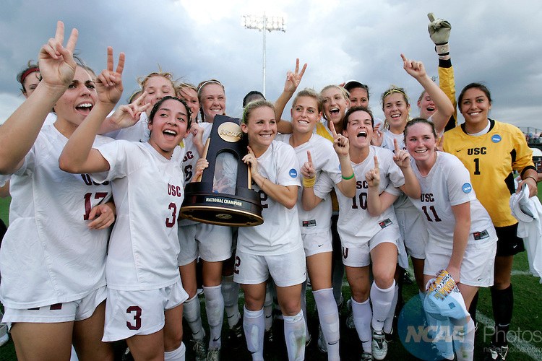
Division I Eligibility Reminders
Minimum core GPA = 2.3.
Ten core courses required prior to beginning of seventh semester.
    Seven of the 10 courses must be English, math or science.
    Ten core courses are “locked in” for GPA purposes.

Slide 7
Three Possible Academic Outcomes for Division I Eligibility
Full Qualifier
  Access to practice, competition and athletics aid in the first year
  Meets all academic requirements of the rule.
Academic Redshirt
  Access to practice and athletics aid only in the first year;
  No competition in the first year;
• Lacks the 10/7; and/or
• Lacks 2.3 GPA.

Slide 8
Three Possible Academic Outcomes for Division I Eligibility Cont.
Non-qualifier
  No practice, no competition, no athletics aid in first year; and
  Three seasons of competition; may earn fourth season back.
Remember that these rules govern the college-bound student-athlete’s first academic year in residence. Student- athletes may gain or lose their eligibility each term based on institutional, conference and NCAA rules.

Slide 9
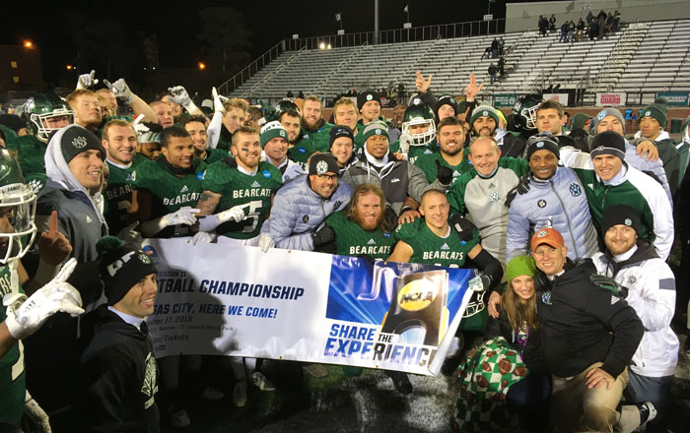
Division II Eligibility Requirements
Complete the required 16 core courses
Earn a minimum 2.20 GPA or better in your core courses

Slide 10
Classes to be aware of for NCAA
The following classes are core classes in Olathe, but do not count for NCAA Eligibility:
Applied Algebra
Applied Geometry
Intermediate Algebra
Horticulture
Earth & Space Science
There may be other core classes that are building specific to check for. See your school’s list of approved classes at: https://web3.ncaa.org/hsportal/exec/hsAction?hsActionSubmit=searchHighSchool

Slide 13
NAIA Eligibility – another great opportunity for student athletes
Initial eligibility for incoming college freshmen is simple. The NAIA does not have any core course requirements and can be determined as early as the summer following your junior year.
To participate in athletics in the NAIA, you must be admitted to the college or university under admission standards equal to or higher than those applied to the general student body.

Slide 14
Division II, Division III, NAIA, Junior College
Each division has different rules governing their athletes.
Refer to each website:
  Division 2: http://www.ncaa.org/d2
  Division 3: http://www.ncaa.org/d3
  NAIA: http://www.playnaia.org/page/process.php
  Junior College: https://www.njcaa.org/landing/index

Slide 15
NCAA ELIGIBILITY CENTER
1. Create an account at eligibilitycenter.org
2. Register with a valid email address you will have access to after high school (personal email NOT school email!)
3. Enter student information, education history, student sport participation history
4. Payment - $90 (fee waiver available for
Students eligible for free or reduced lunch)

Slide 16
Contact Information
Olathe East
AD – Mike Wolgast
Counselor – Whitney Schmale
Olathe North
AD – Josh Price
Counselor – Nicole Etherton
Olathe Northwest
AD – Steve Page
Counselor – Heather Jasper
Olathe South
AD – Phil Simons
Counselor – Chad Hoffman
Olathe West
AD – Pat Butler
Counselor –Brian Frick

